Slide 1
UNIT 3
Estimation And Scheduling

Slide 2
Estimation for Software Projects
Project planning
Scope and feasibility
Project resources
Estimation of project cost and effort
Decomposition techniques
Empirical estimation models

Slide 3
Project Planning

Slide 4
Software Project Planning
Software project planning encompasses five major activities
Estimation,
scheduling,
risk analysis,
quality management planning, and
change management planning
4

Slide 5
Estimation determines how much money, effort, resources, and time it will take to build a specific system or product
The software team first estimates
The work to be done
The resources required
The time that will elapse from start to finish
Then they establish a project schedule that
Defines tasks and milestones
Identifies who is responsible for conducting each task
Specifies the inter-task dependencies

Slide 6
Observations on Estimation
Planning requires technical managers and the software team to make an initial commitment
Process and project metrics can provide a historical perspective and valuable input for generation of quantitative estimates
Past experience can aid greatly
Estimation carries inherent risk, and this risk leads to uncertainty
The availability of historical information has a strong influence on estimation risk
5

Slide 7
Observations on Estimation (continued)
When software metrics are available from past projects
Estimates can be made with greater assurance
Schedules can be established to avoid past difficulties
Overall risk is reduced
Estimation risk is measured by the degree of uncertainty in the quantitative estimates for cost, schedule, and resources
Nevertheless, a project manager should not become obsessive about estimation
Plans should be iterative and allow adjustments as time passes and more is made certain
6

Slide 8
Task Set for Project Planning
Establish project scope
Determine feasibility
Analyze risks
Define required resources
Determine human resources required
Define reusable software resources
Identify environmental resources
Estimate cost and effort
Decompose the problem
Develop two or more estimates using different approaches
Reunite the estimates
Develop a project schedule
Establish a meaningful task set
Define a task network
Use scheduling tools to develop a timeline chart
Define schedule tracking mechanisms
7

Slide 9
Scope and Feasibility

Slide 10
Software Scope
Software scope describes
The functions and features that are to be delivered to end users
The data that are input to and output from the system
The "content" that is presented to users as a consequence of using the software
The performance, constraints, interfaces, and reliability that bound the system
Scope can be define using two techniques
A narrative description of software scope is developed after communication with all stakeholders
A set of use cases is developed by end users
9

Slide 11
Software Scope (continued)
After the scope has been identified, two questions are asked
Can we build software to meet this scope?
Is the project feasible?
Software engineers too often rush (or are pushed) past these questions
Later they become mired in a project that is doomed from the onset
10

Slide 12
Feasibility
After the scope is resolved, feasibility is addressed
Software feasibility has four dimensions
Technology – Is the project technically feasible? Is it within the state of the art? Can defects be reduced to a level matching the application's needs?
Finance – Is is financially feasible? Can development be completed at a cost that the software organization, its client, or the market can afford?
Time – Will the project's time-to-market beat the competition?
– Resources – Does the software organization have the resources needed to succeed in doing the project?
11

Slide 13
Project Resources

Slide 14
Resource Estimation
Three major categories of software engineering resources
People
Development environment
Reusable software components
Often neglected during planning but become a paramount concern during the construction phase of the software process
Each resource is specified with
A description of the resource
A statement of availability
The time when the resource will be required
The duration of time that the resource will be applied
Time window
13

Slide 15
Categories of Resources
People
Number required
Skills required
Geographical location
Development Environment
Software tools
Computer hardware
Network resources
The Project
Reusable Software Components
Off-the-shelf components
Full-experience components
Partial-experience components
New components
14

Slide 16
Human Resources
Planners need to select the number and the kind of people
skills needed to complete the project
They need to specify the organizational position and job specialty for each person
Small projects of a few person-months may only need one individual
Large projects spanning many person-months or years require the location of the person to be specified also
The number of people required can be determined only after an estimate of the development effort
15

Slide 17
Development Environment Resources
A software engineering environment (SEE) incorporates hardware, software, and network resources that provide platforms and tools to develop and test software work products
Most software organizations have many projects that require access to the SEE provided by the organization
Planners must identify the time window required for hardware and software and verify that these resources will be available
16

Slide 18
Reusable Software Resources
Off-the-shelf components
Components are from a third party or were developed for a previous project
Ready to use; fully validated and documented; virtually no risk
Full-experience components
Components are similar to the software that needs to be built
Software team has full experience in the application area of these components
Modification of components will incur relatively low risk
Partial-experience components
Components are related somehow to the software that needs to be built but will require substantial modification
Software team has only limited experience in the application area of these components
Modifications that are required have a fair degree of risk
New components
Components must be built from scratch by the software team specifically for the
needs of the current project
Software team has no practical experience in the application area
Software development of components has a high degree of risk
17

Slide 19
Estimation of Project Cost and Effort

Slide 20
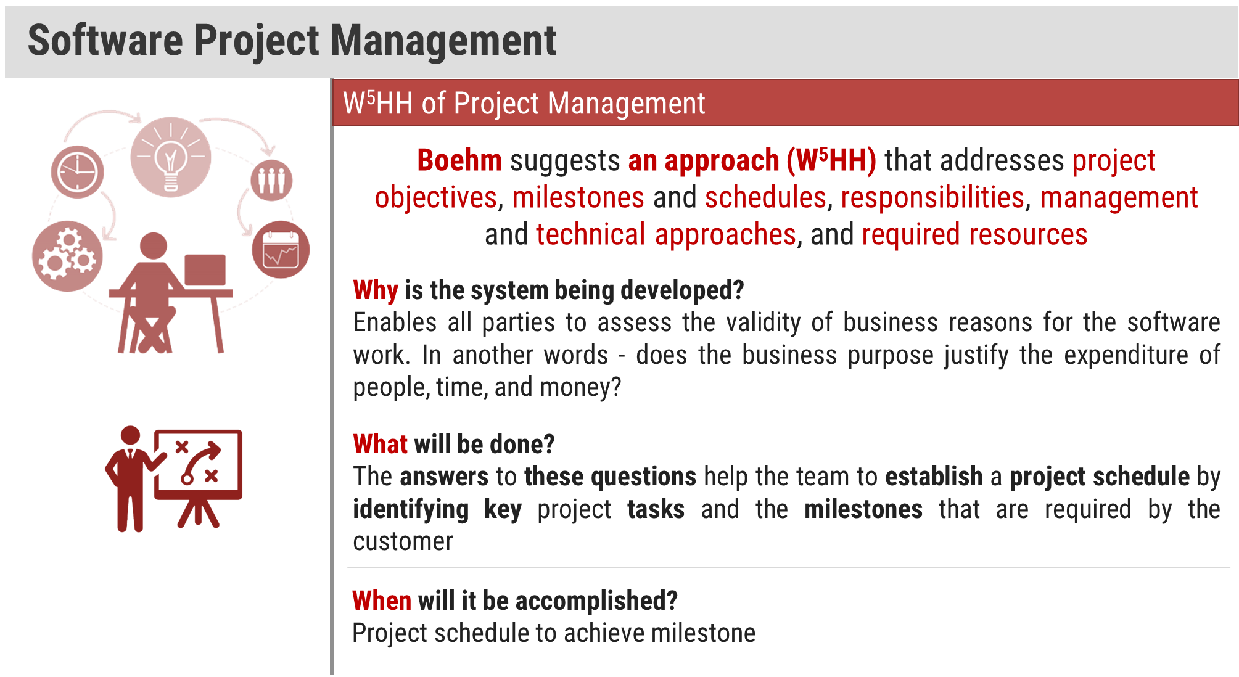

Slide 21
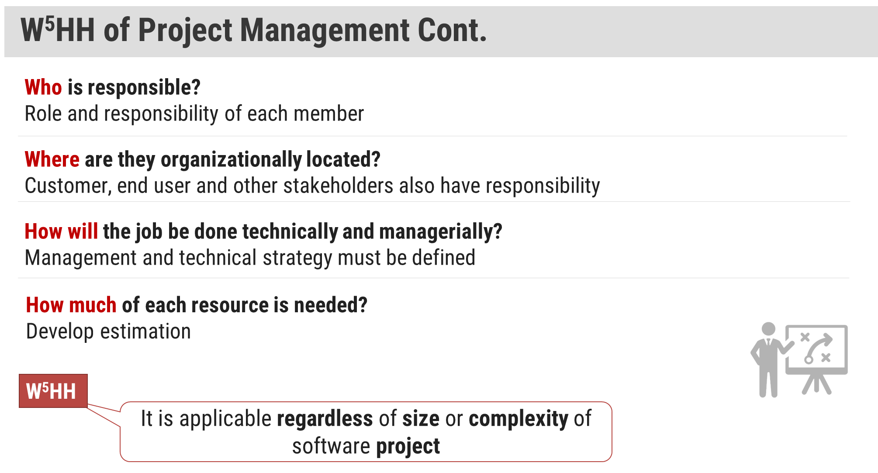

Slide 22
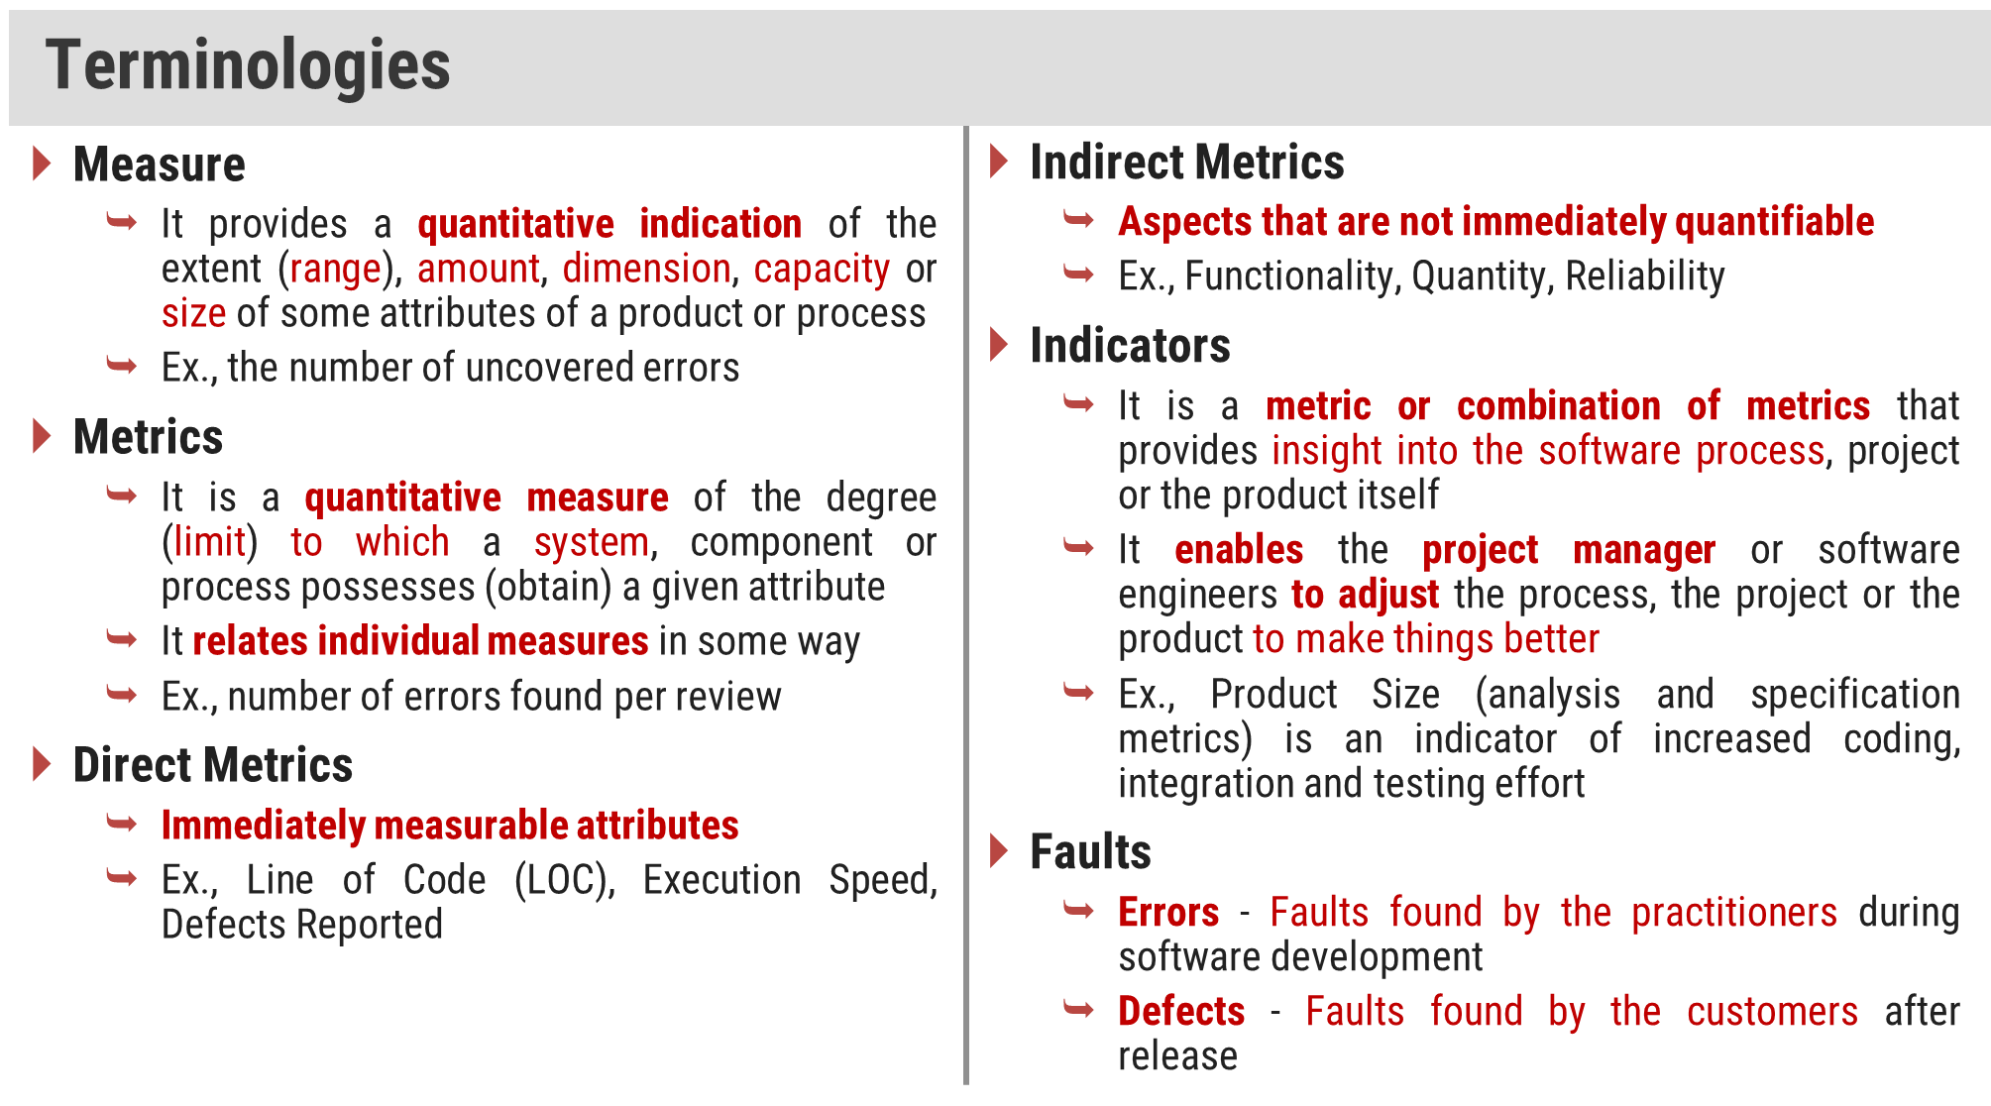

Slide 23
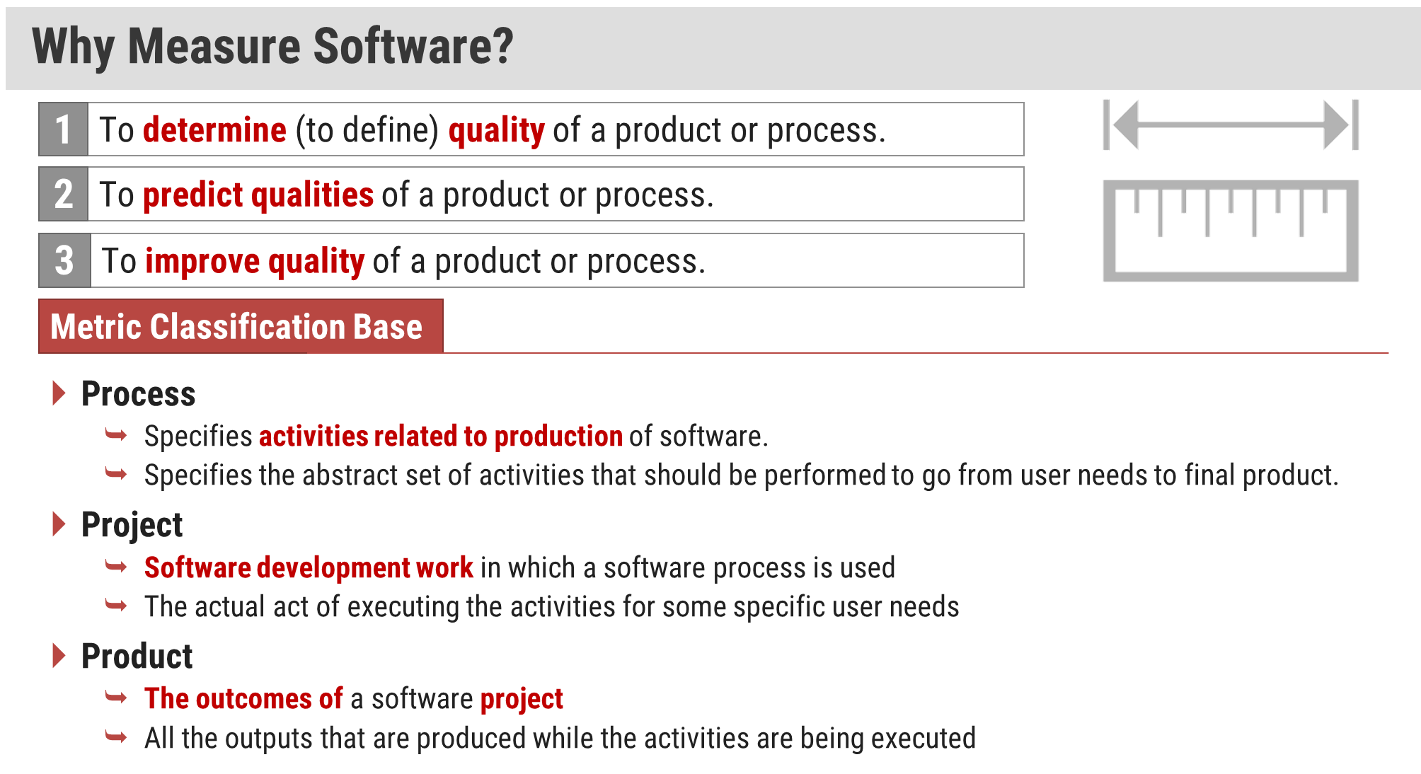

Slide 24
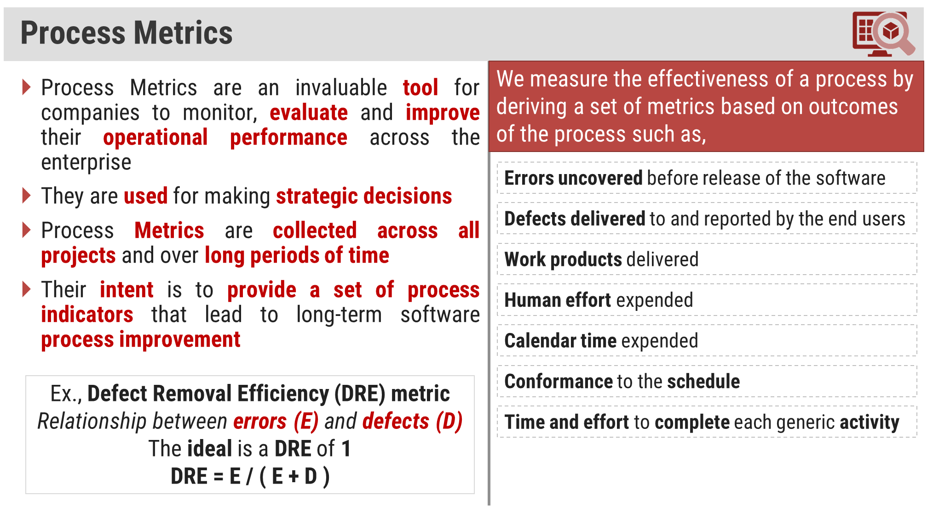

Slide 25
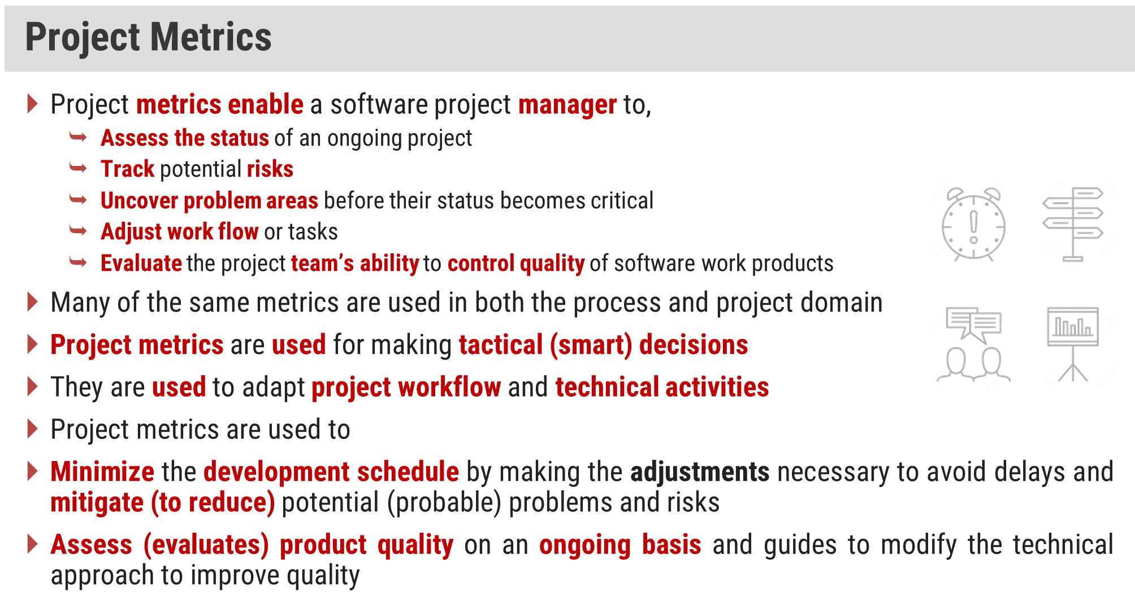

Slide 26
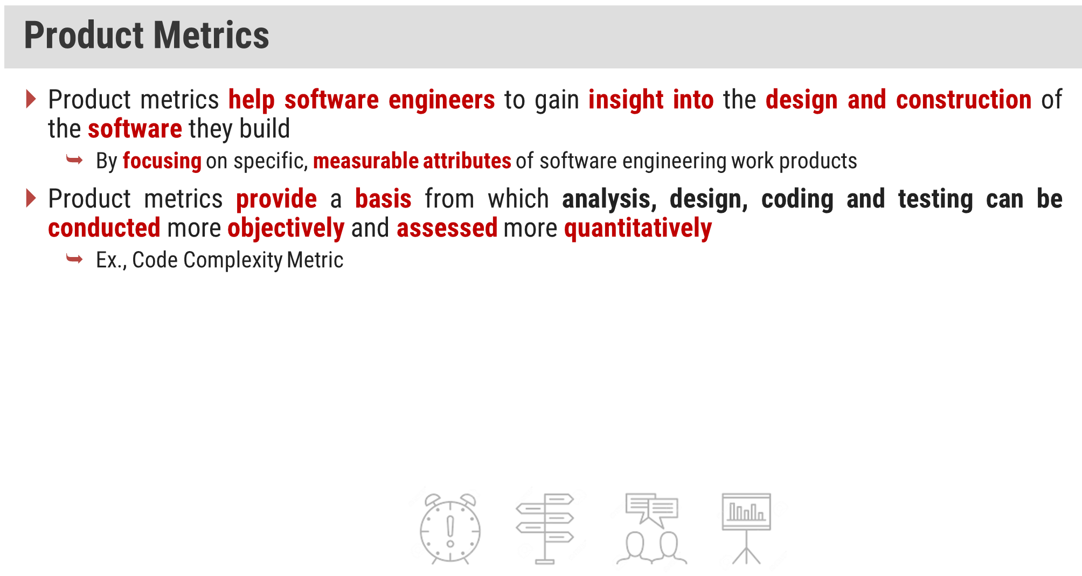

Slide 27
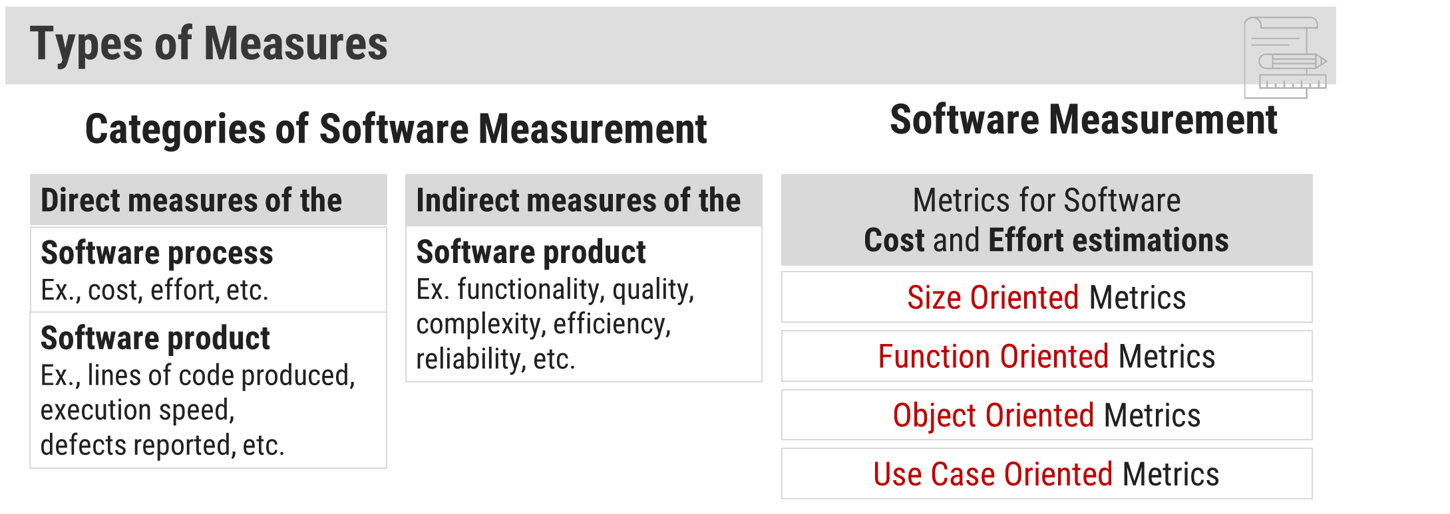

Slide 28
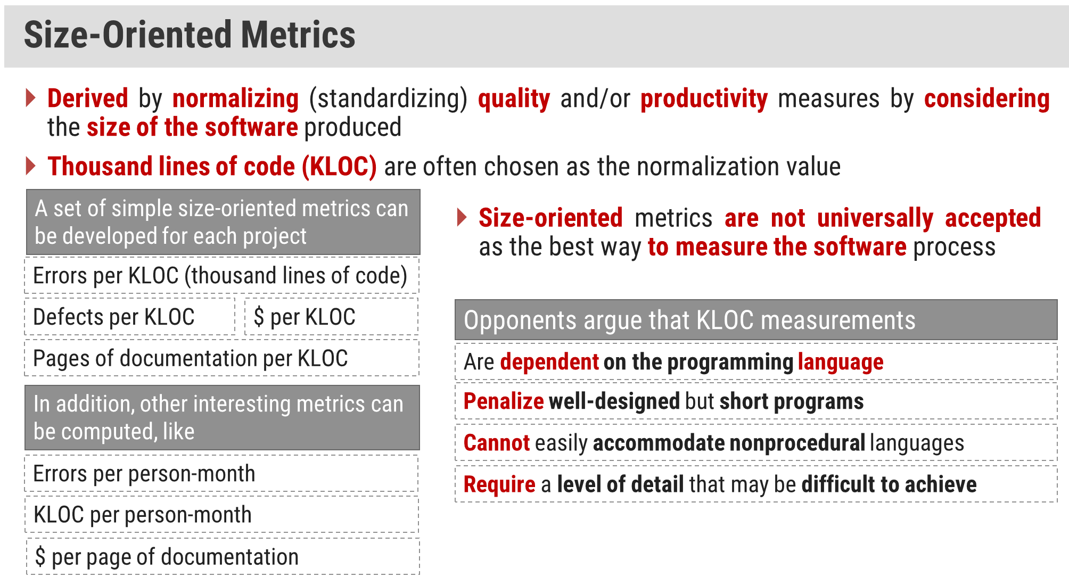

Slide 29
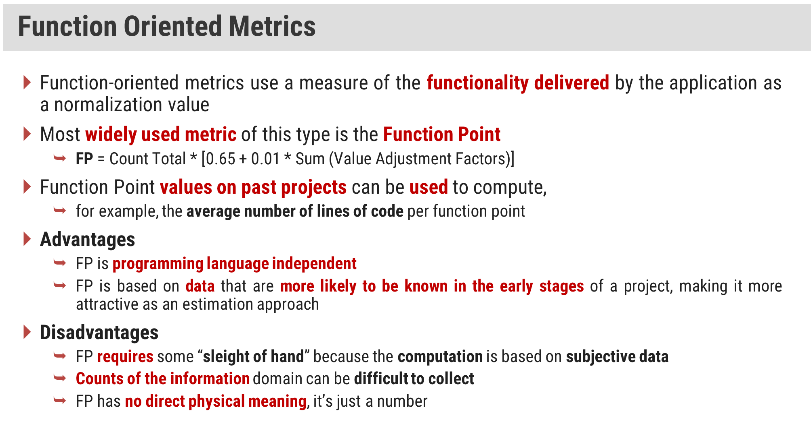

Slide 30
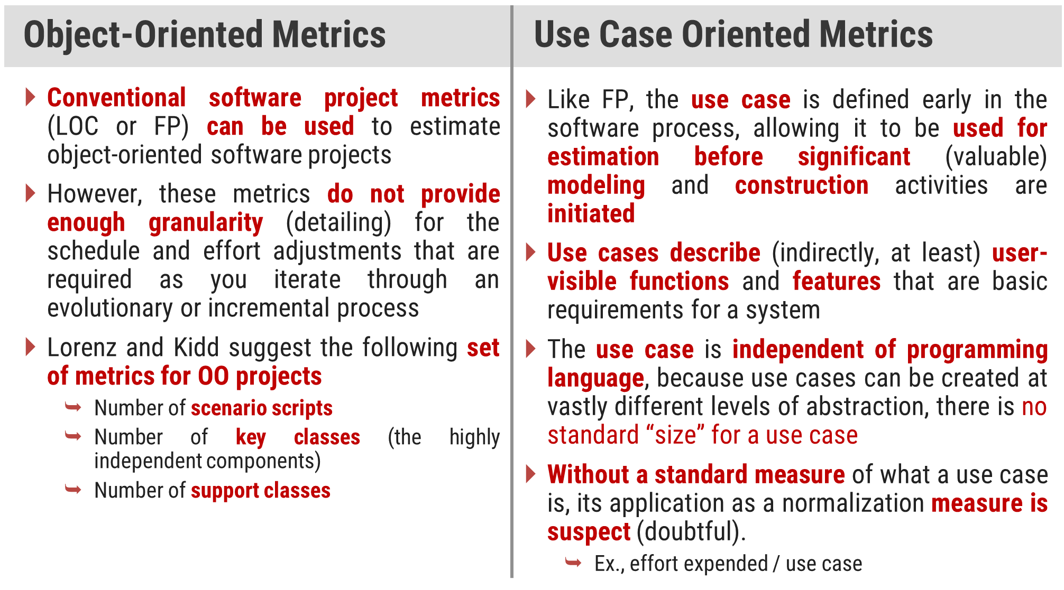

Slide 31
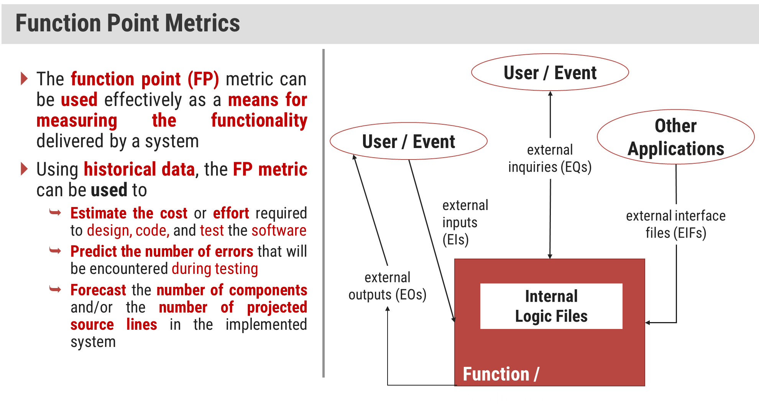

Slide 32
Function Point Components
Information domain values (components) are defined in the following manner
Number of external inputs (EIs)
input data originates from a user or is transmitted from another application
Number of external outputs (EOs)
external output is derived data within the application that provides information to the user
output refers to reports, screens, error messages, etc.
Number of external inquiries (EQs)
external inquiry is defined as an online input that results in the generation of some immediate software response in the form of an online output
Number of internal logical files (ILFs)
internal logical file is a logical grouping of data that resides within the application’s boundary and is maintained via external inputs
Number of external interface files (EIFs)
external interface file is a logical grouping of data that resides external to the application but provides information that may be of use to the another application

Slide 33
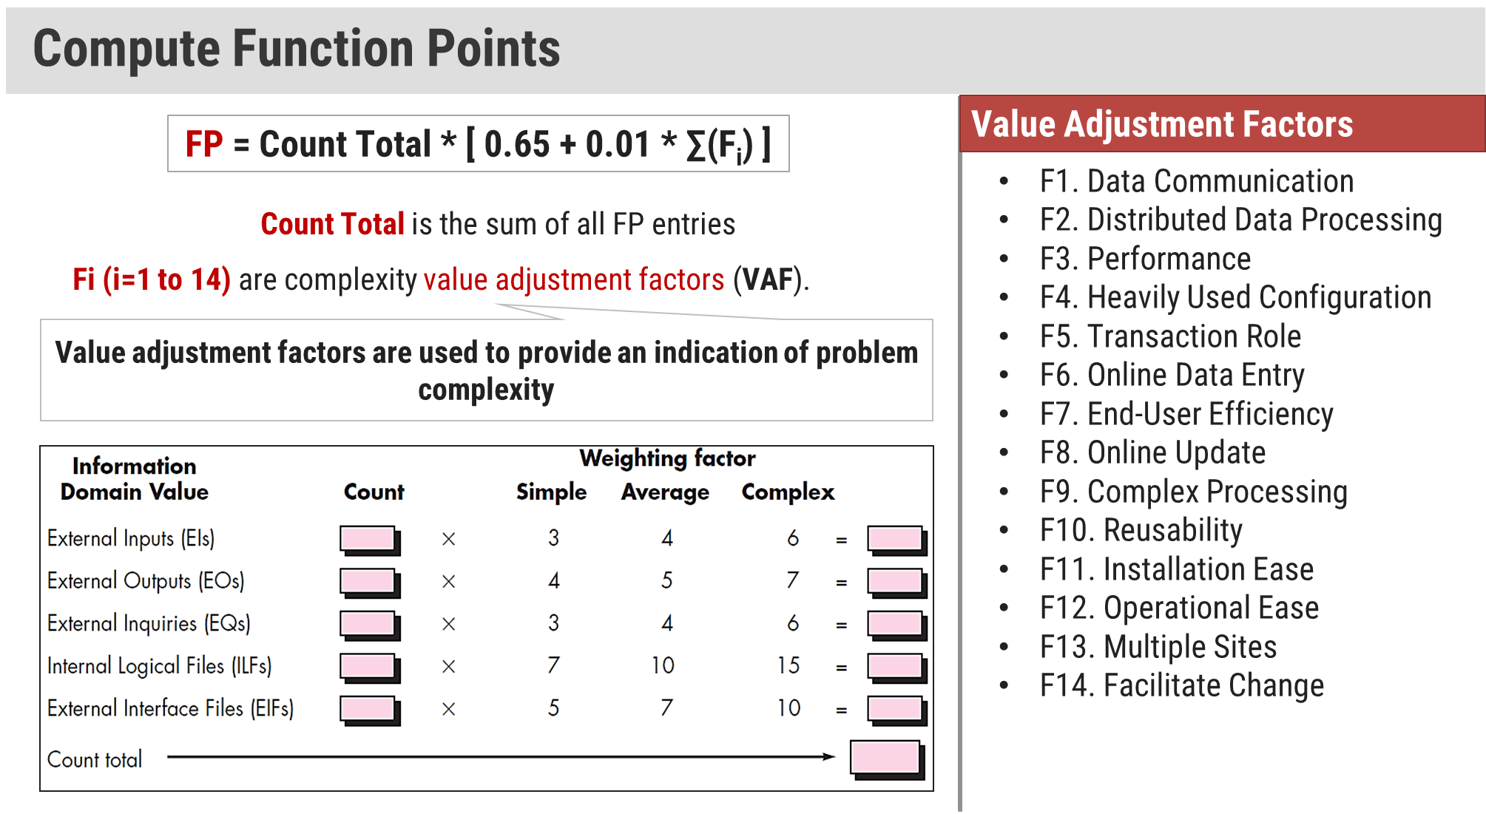

Slide 34
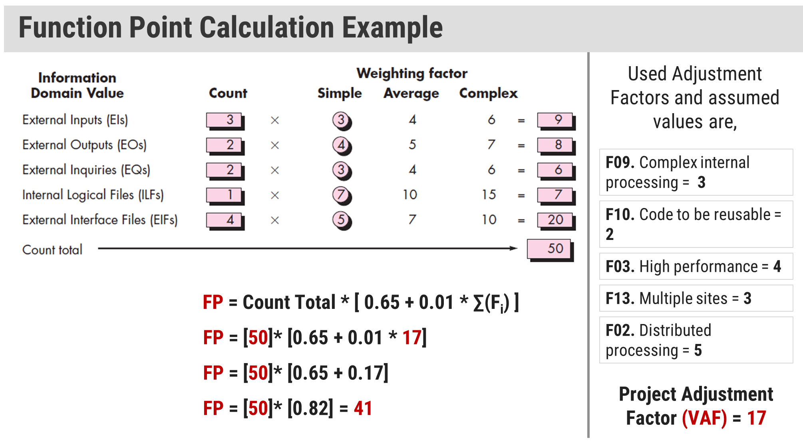

Slide 35
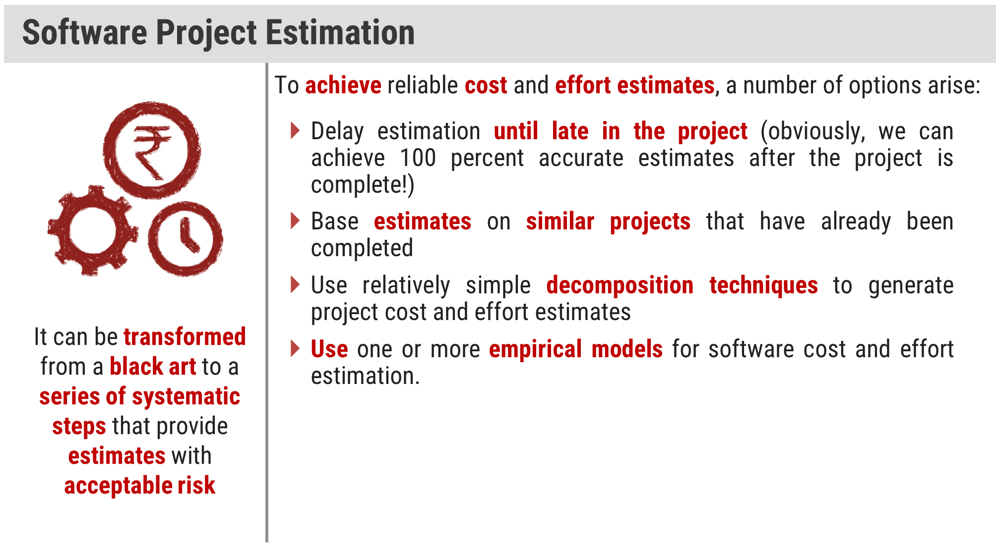

Slide 36
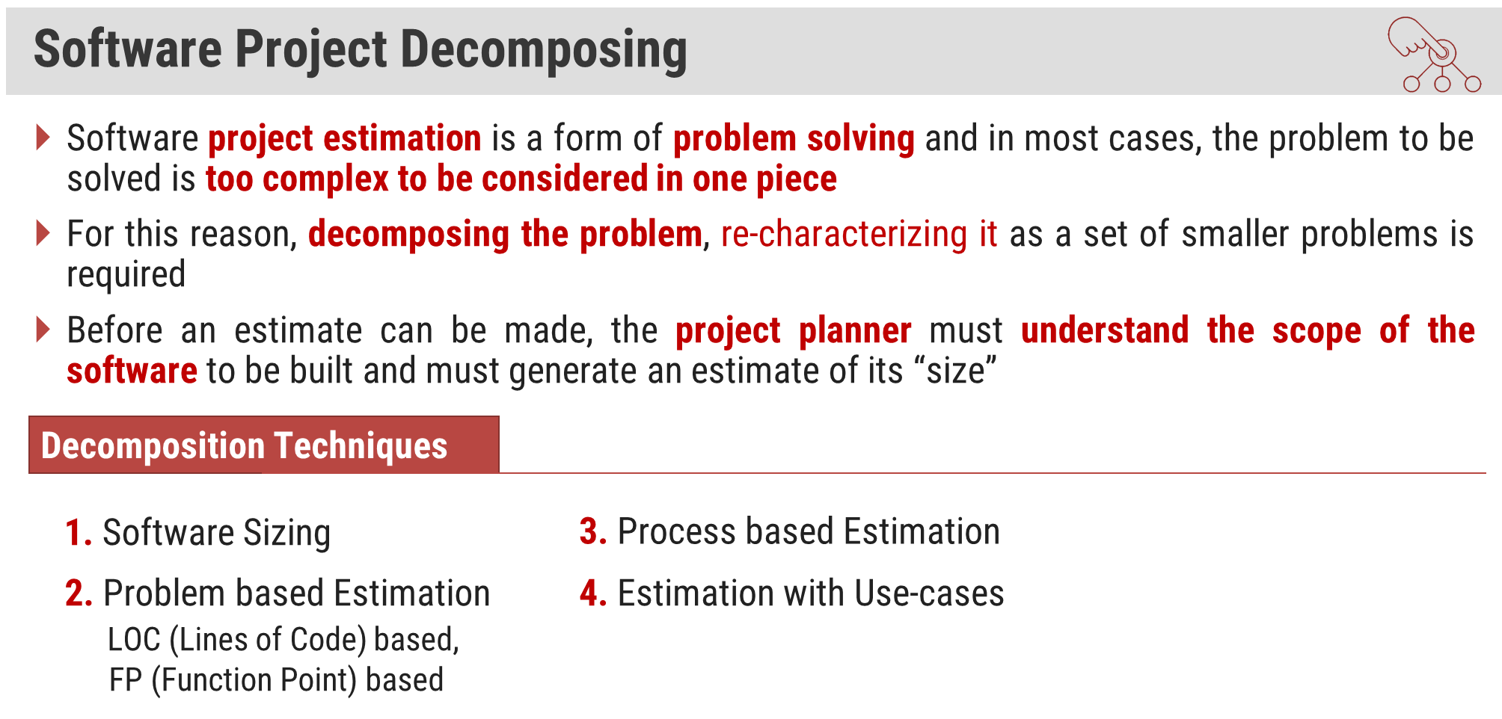

Slide 37
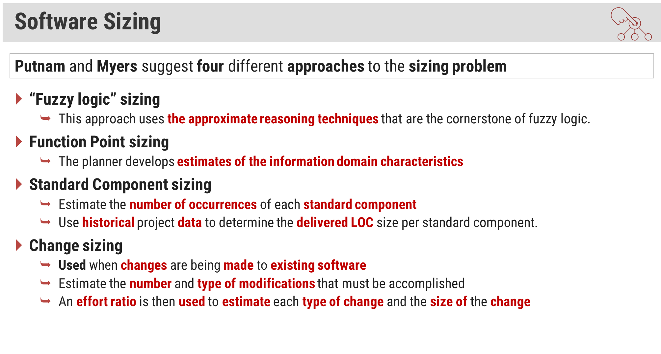

Slide 38
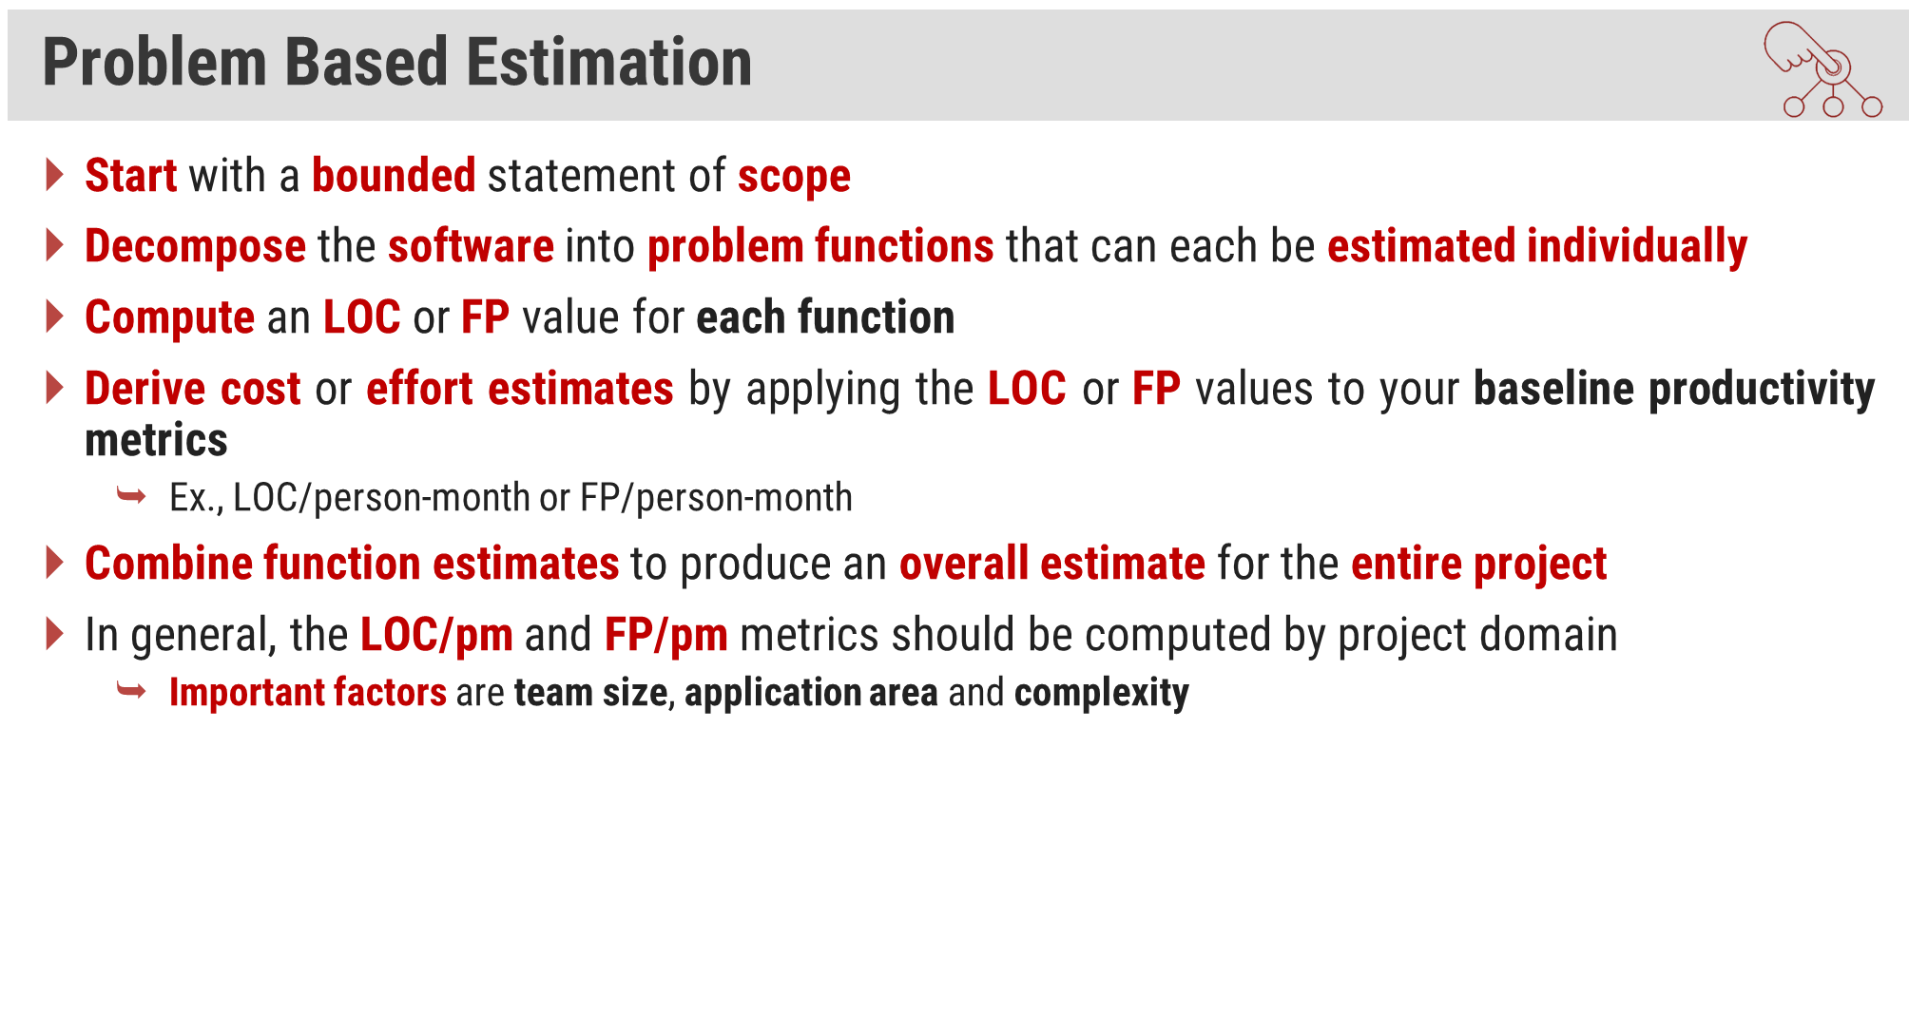

Slide 39
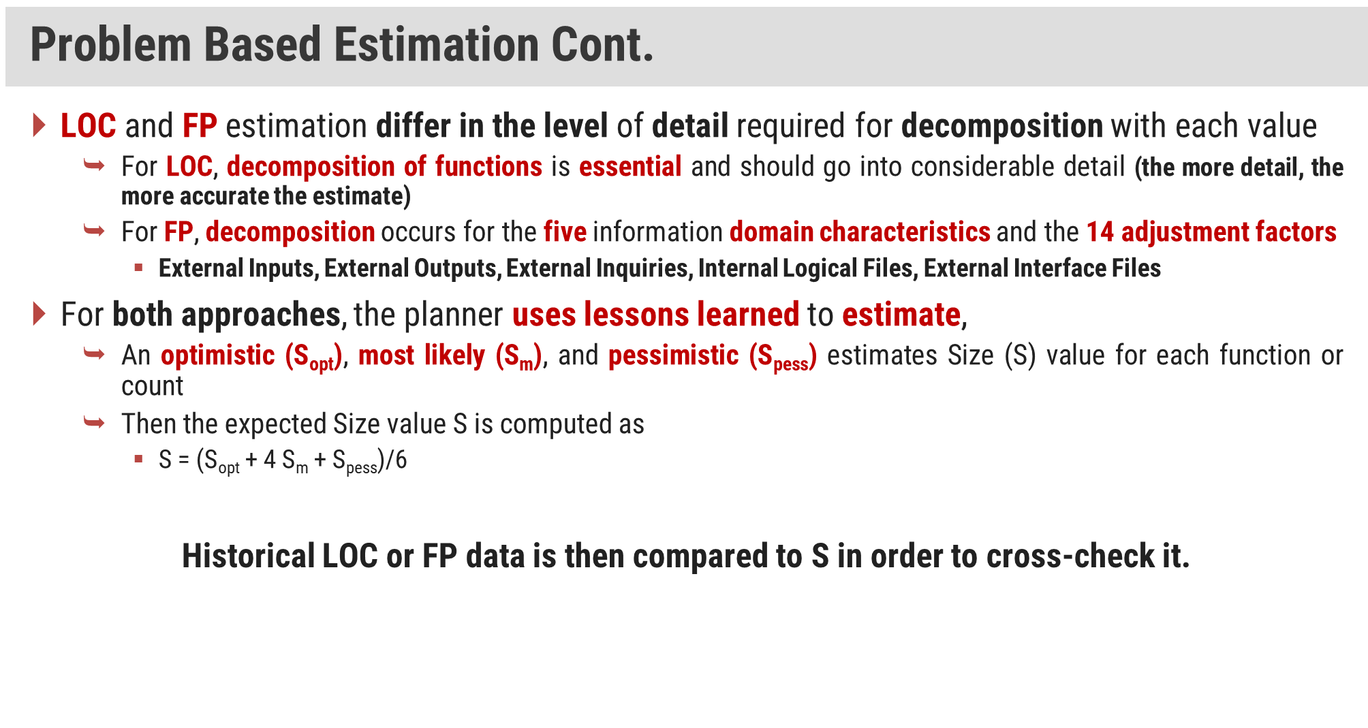

Slide 40
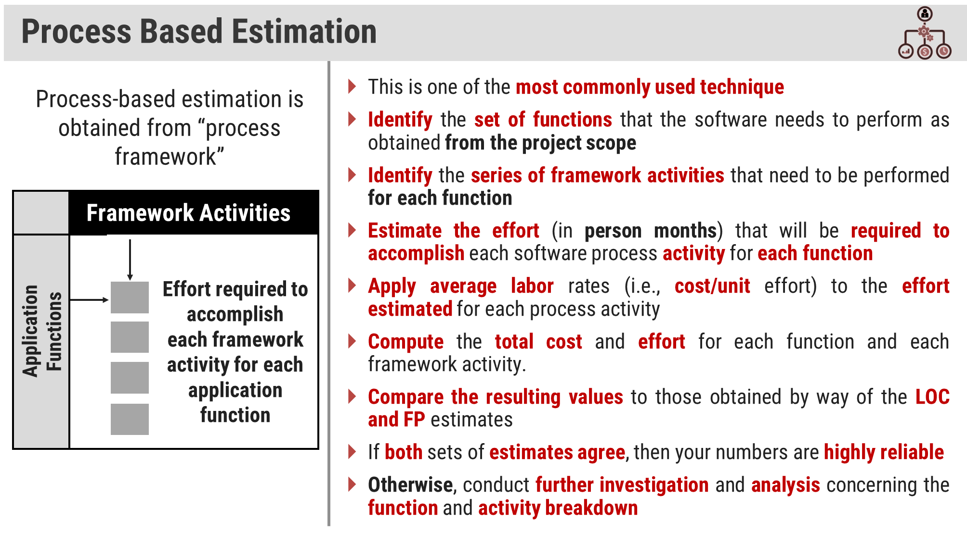

Slide 41
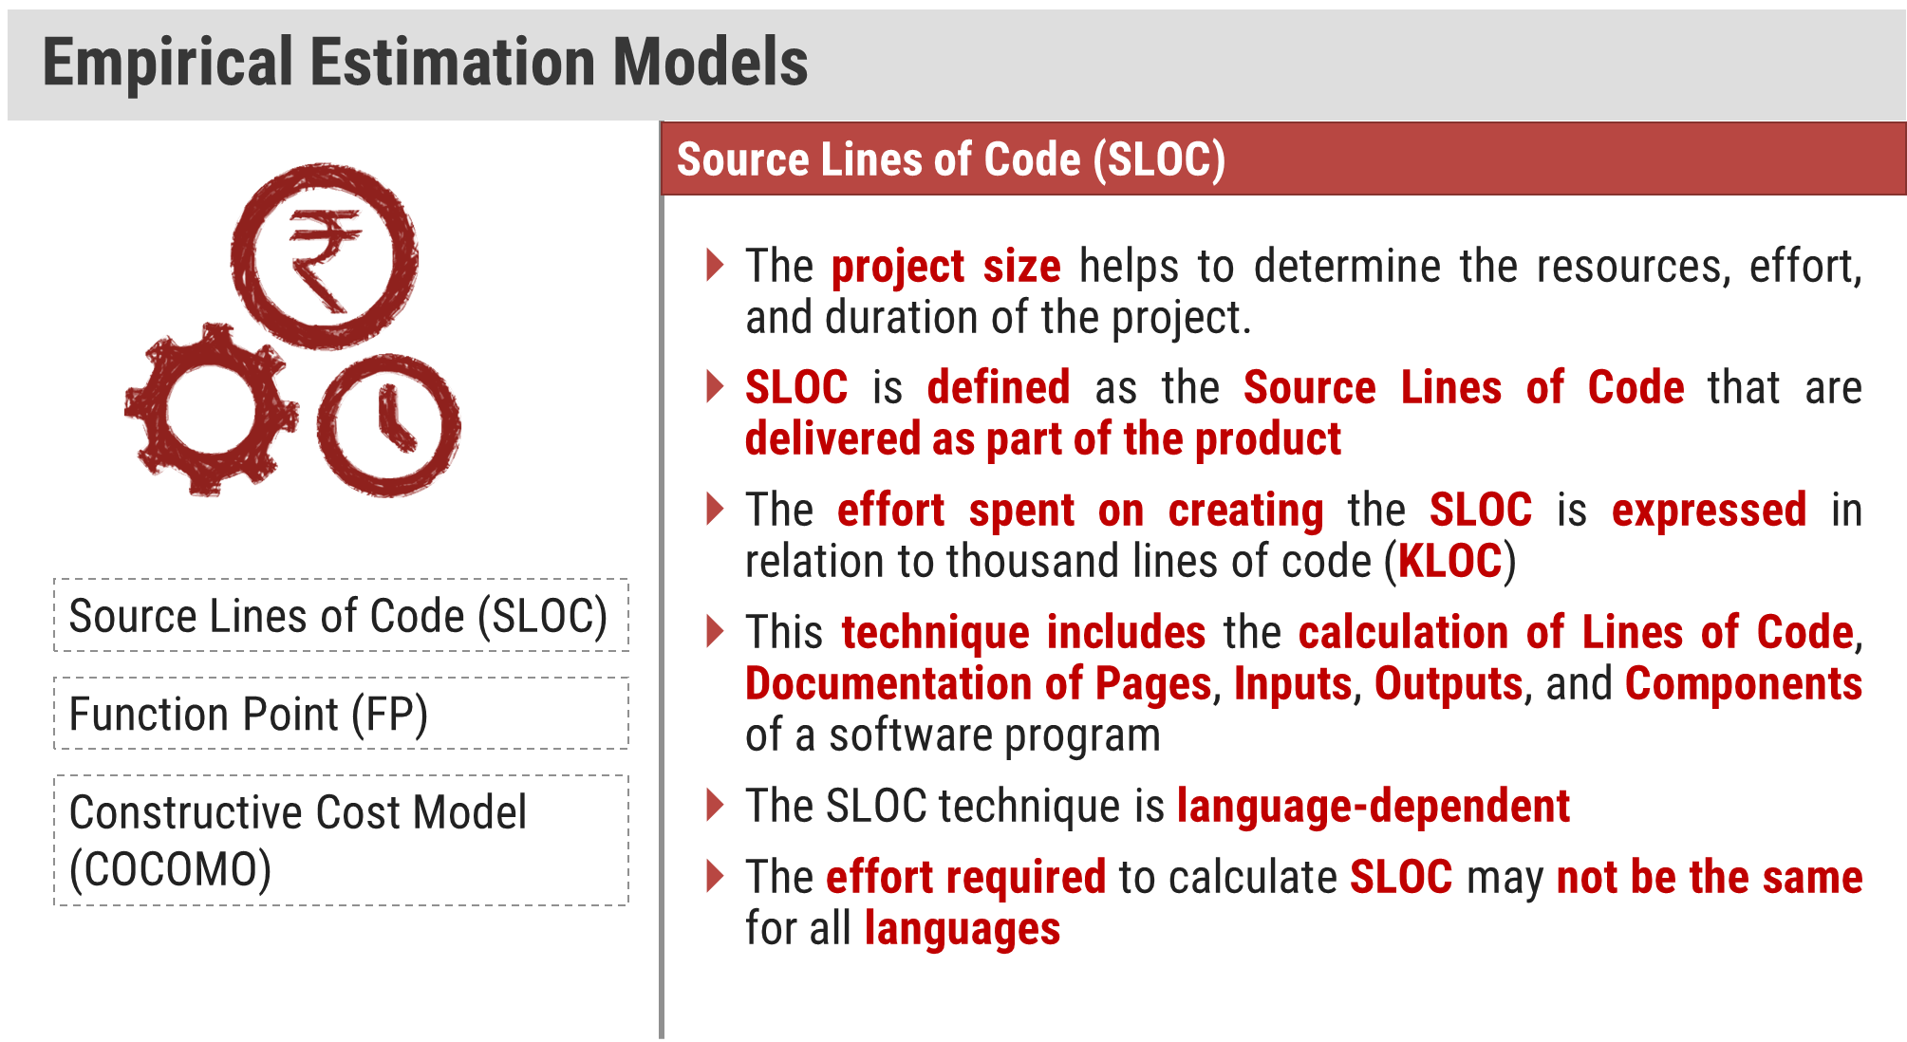

Slide 42
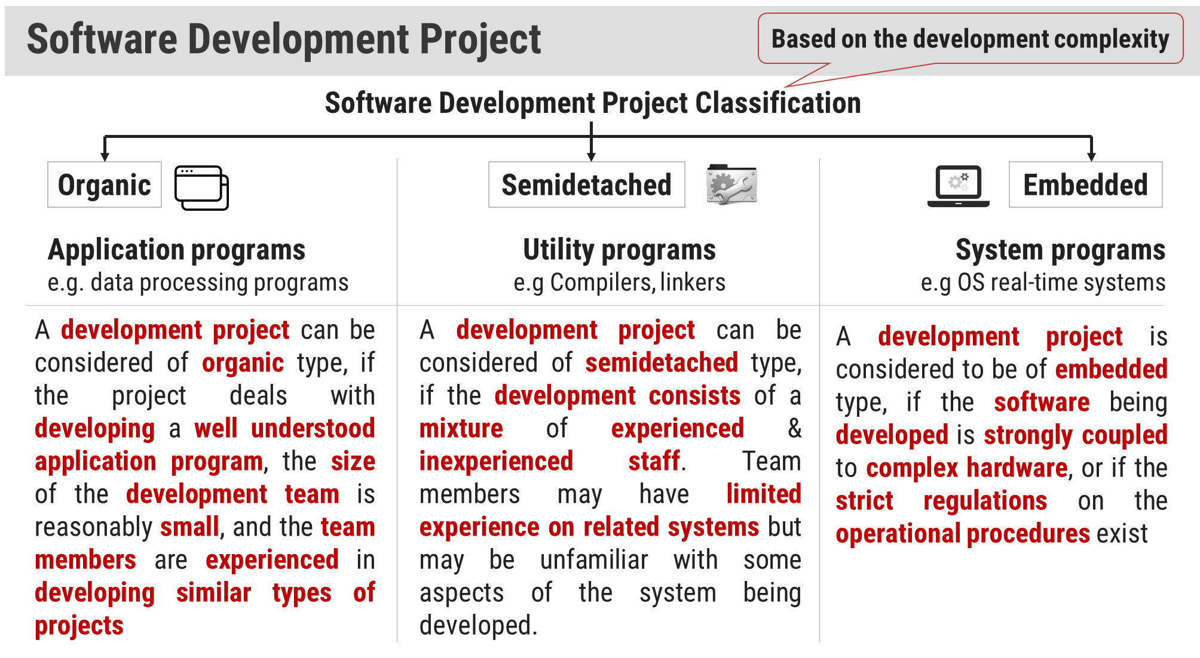

Slide 43
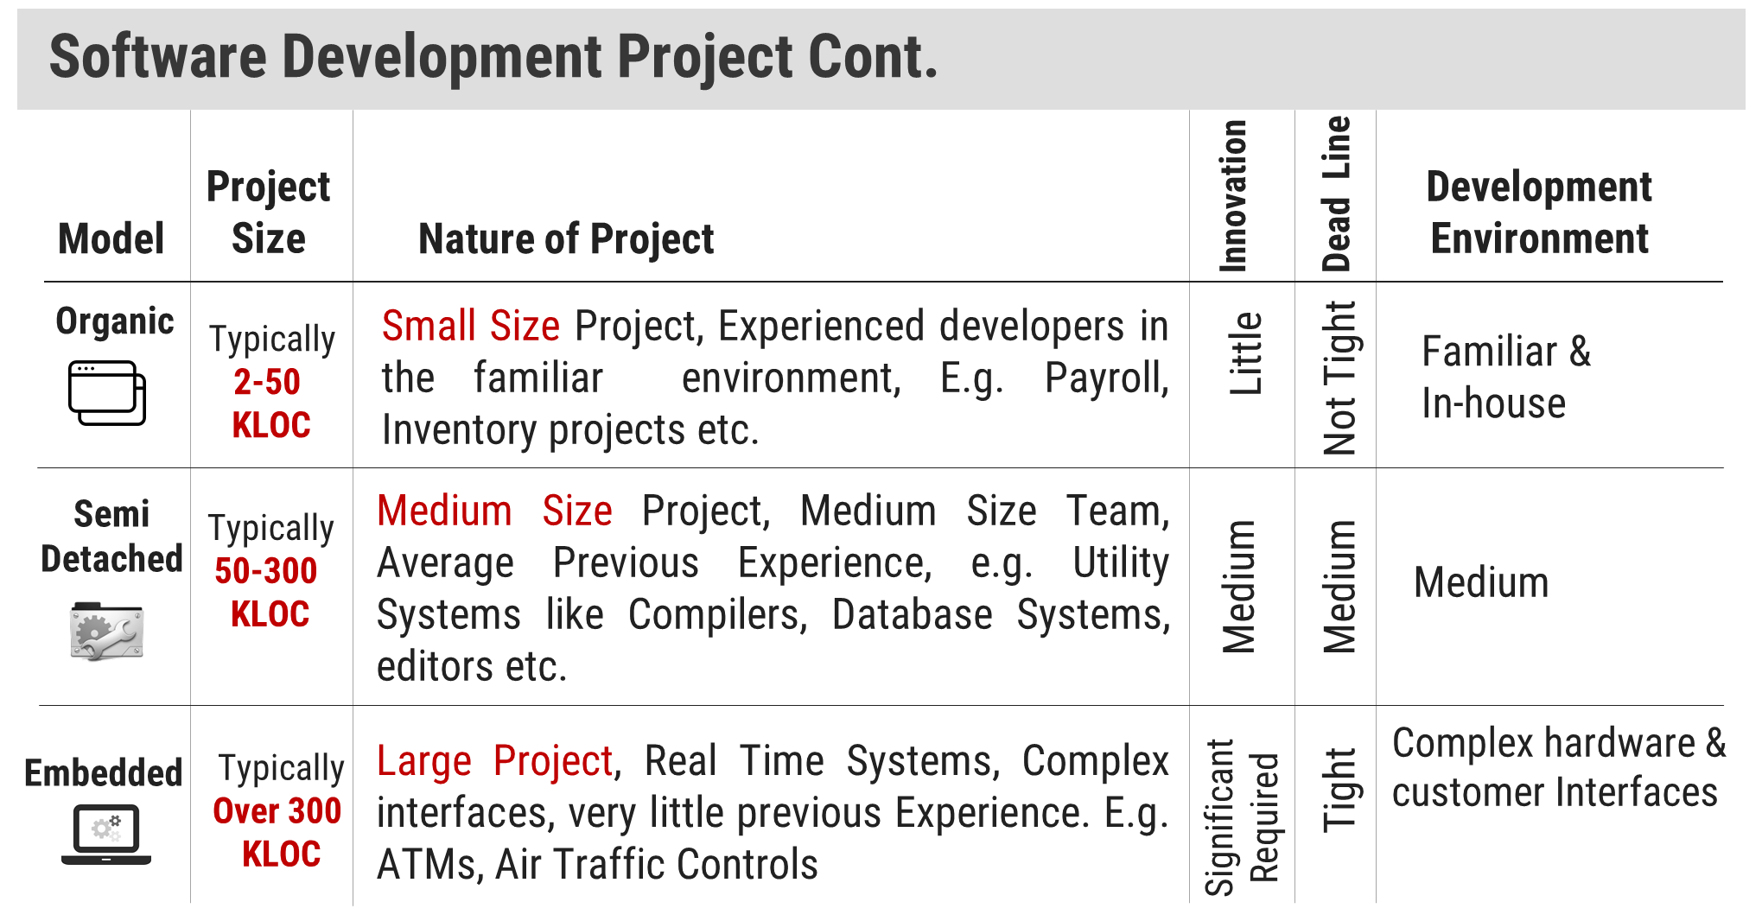

Slide 44
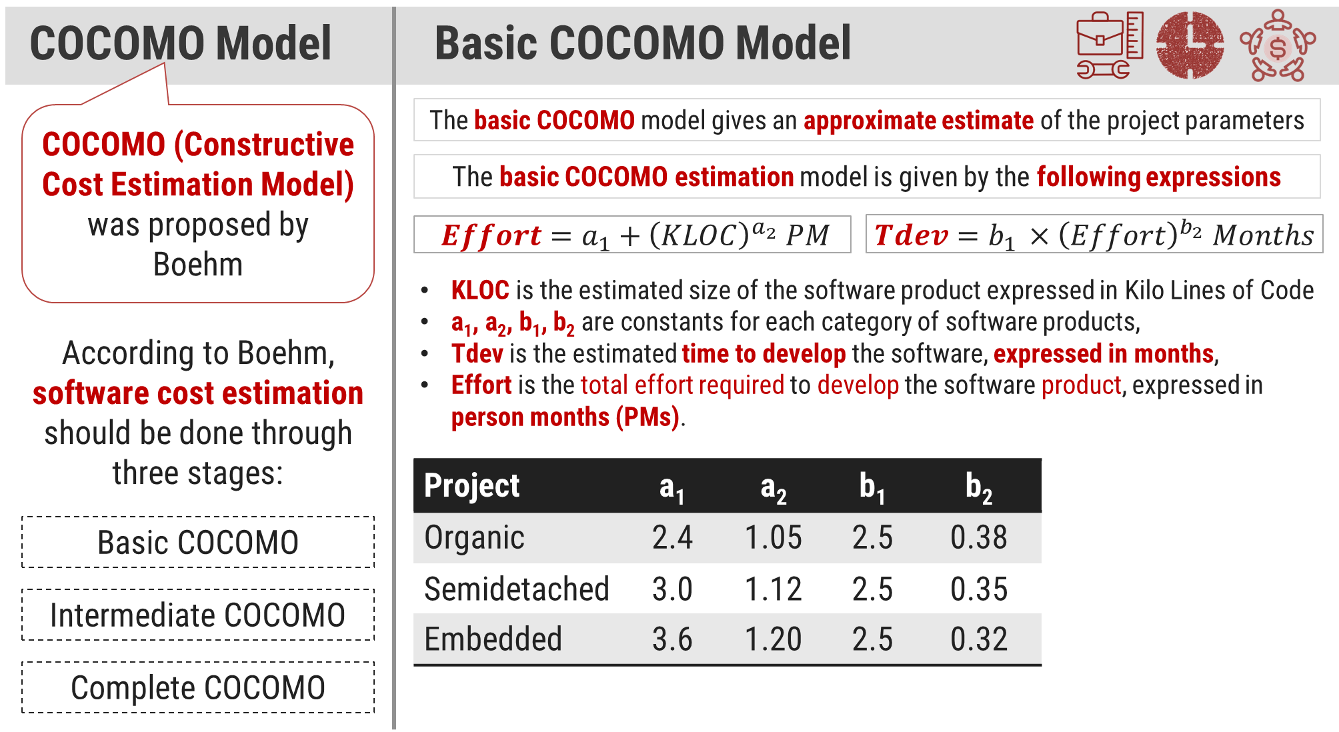

Slide 45
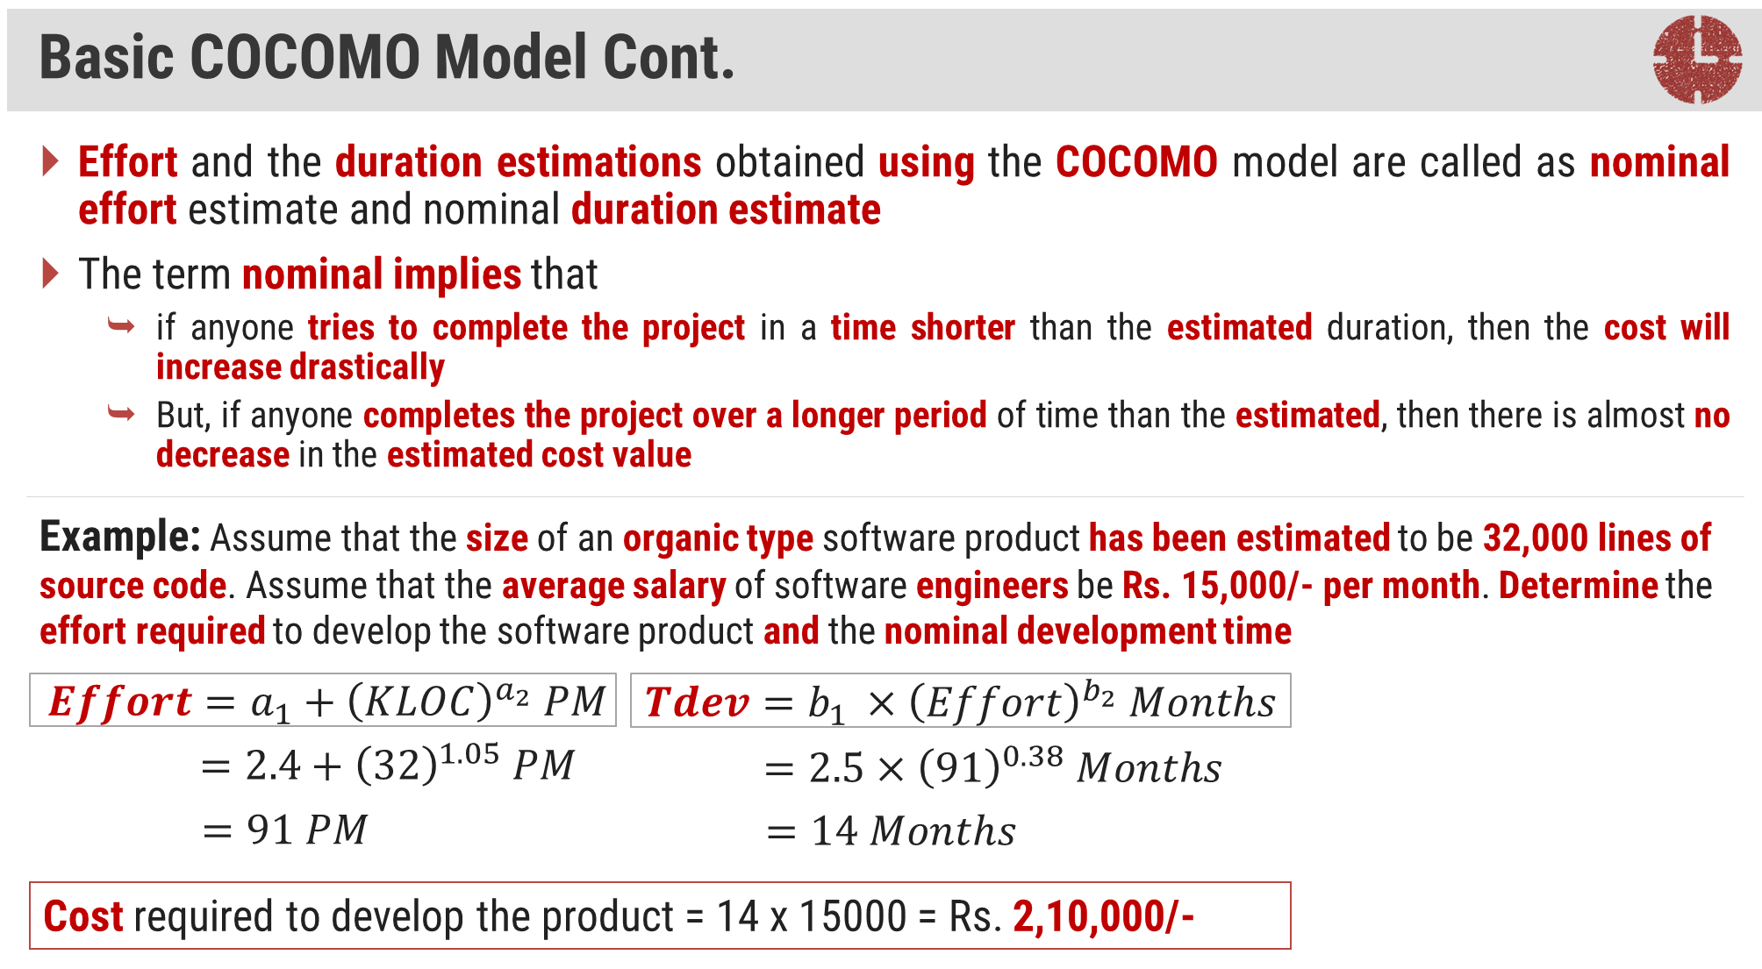

Slide 46
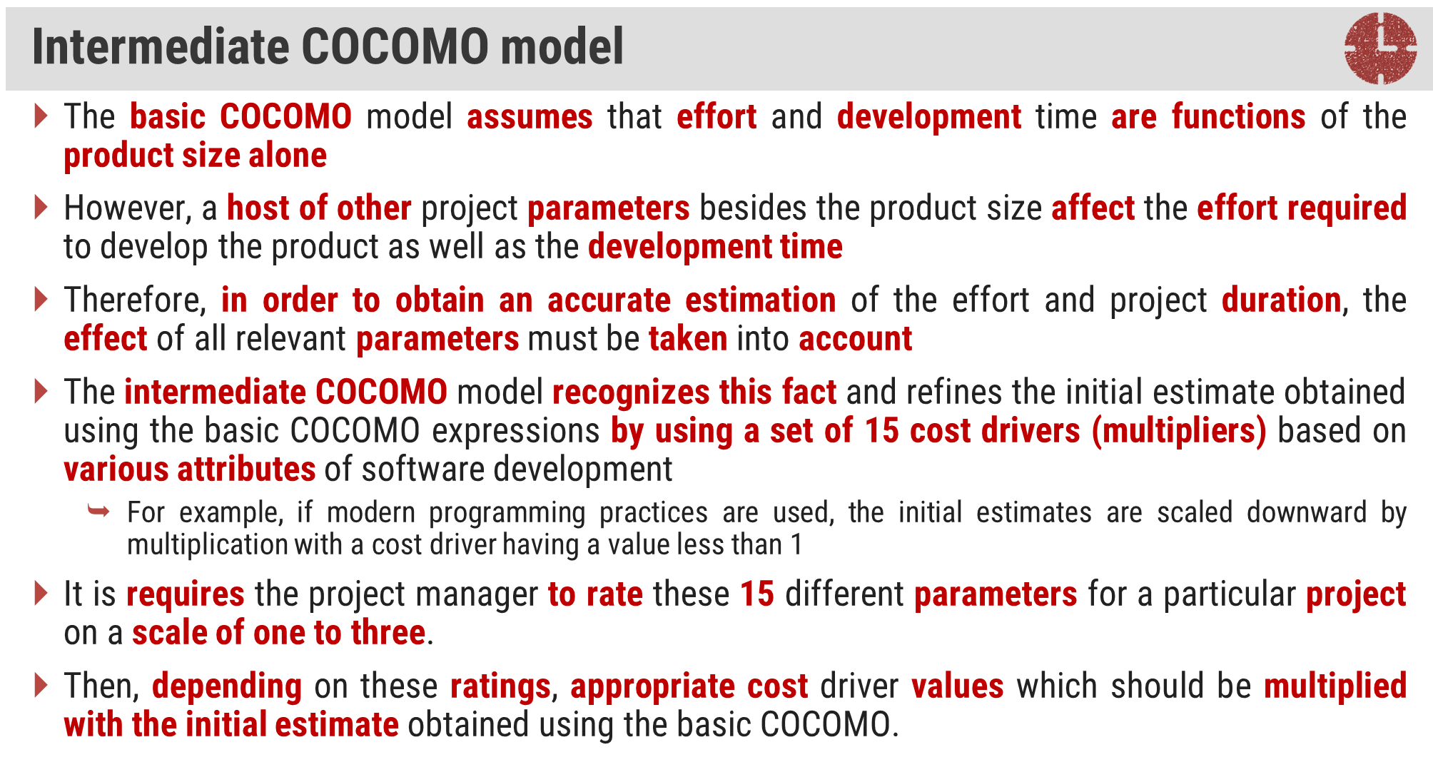

Slide 47
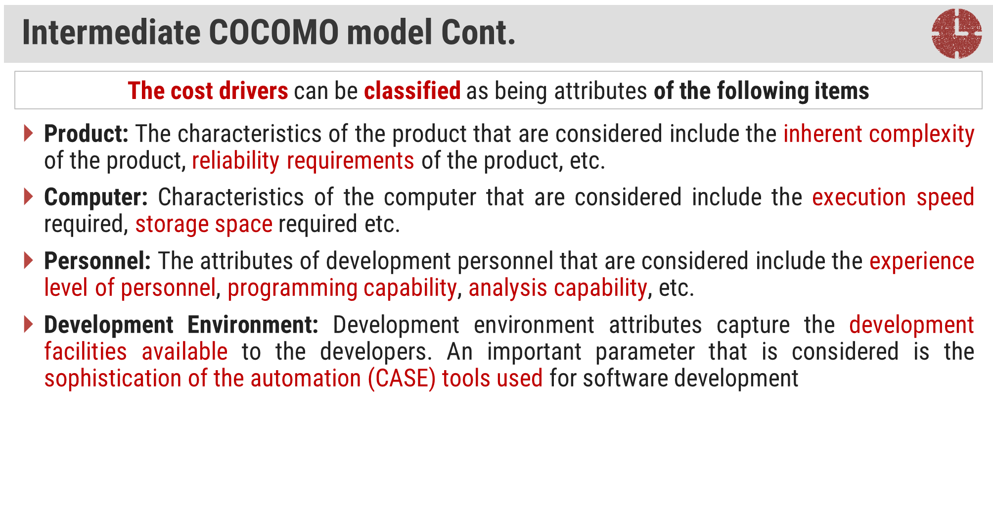

Slide 48
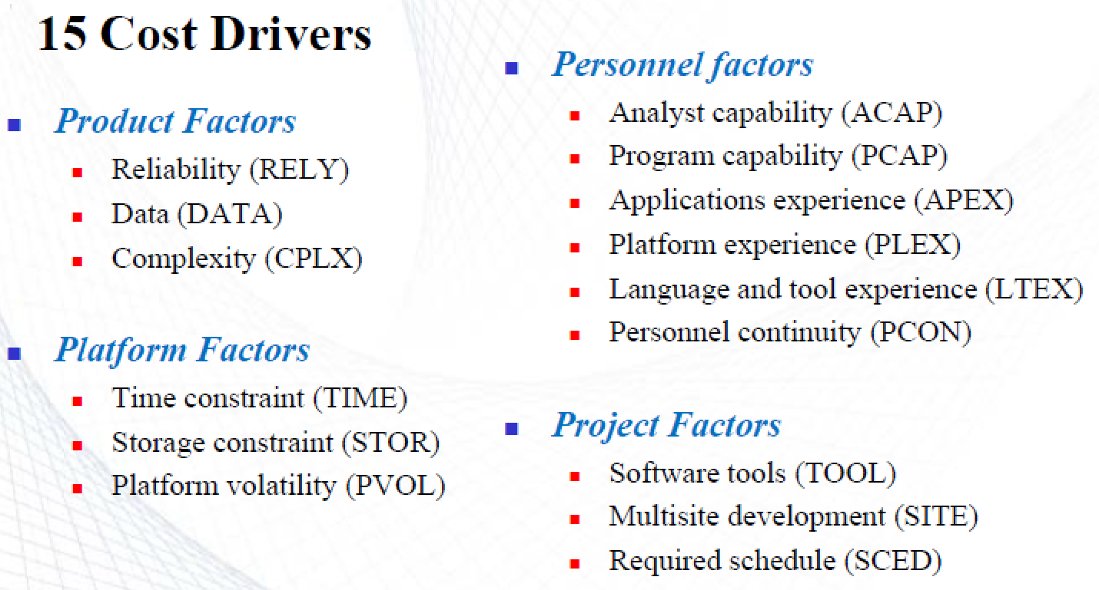
COCOMO INTERMEDIATE MODEL

Slide 49
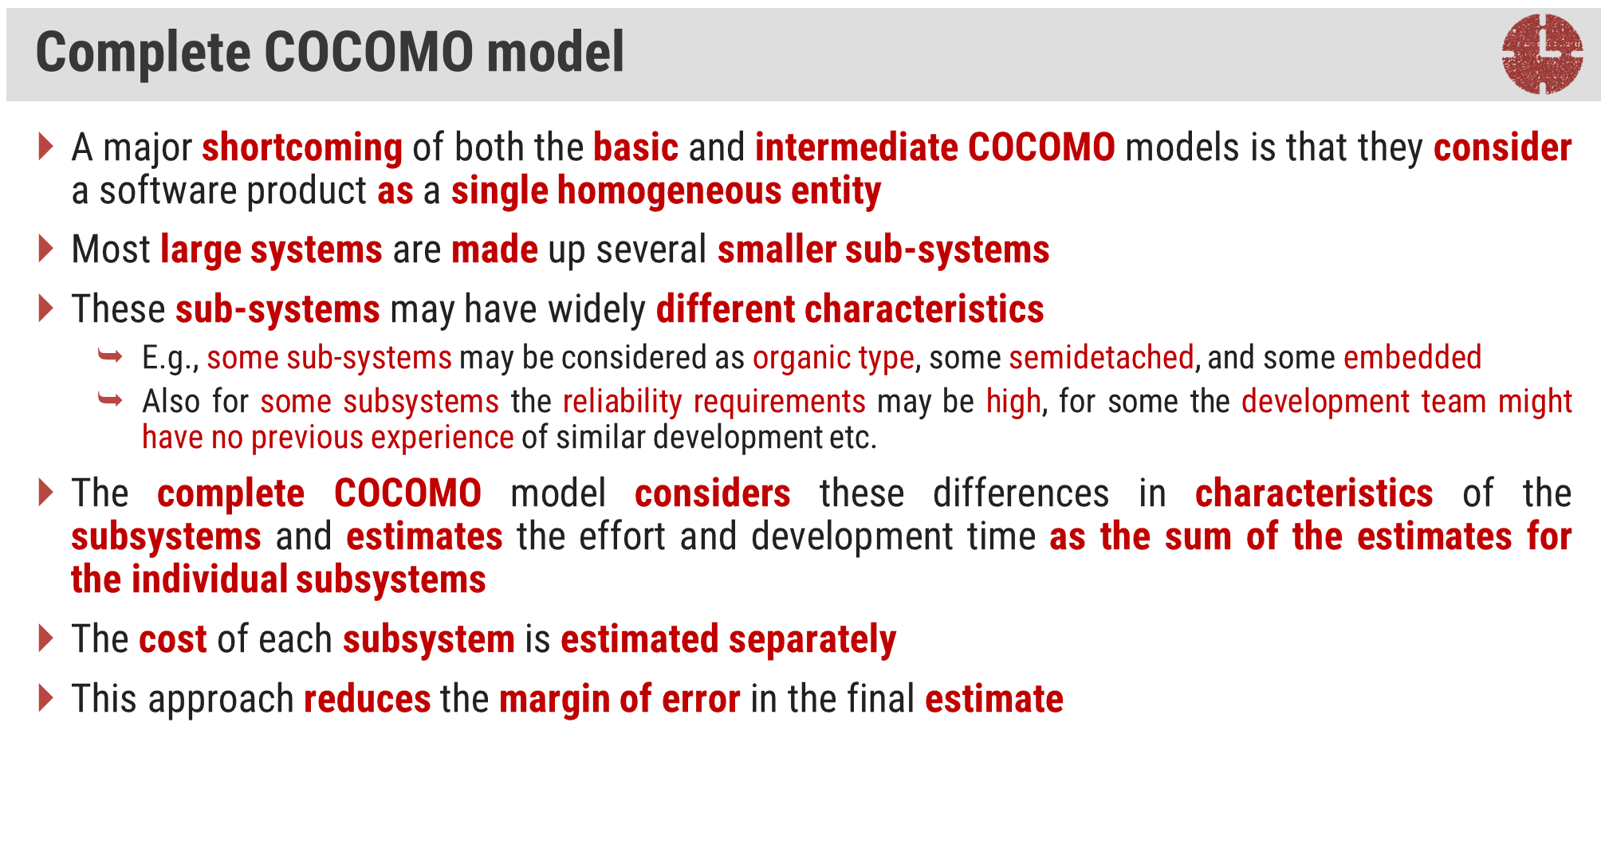

Slide 50
COCOMO II model
COCOMO 2 incorporates a range of sub-models that produce increasingly detailed software estimates.
The sub-models in COCOMO 2 are:
Application composition model. Used when software is composed from existing parts.
Early design model. Used when requirements are available but design has not yet started.
Reuse model. Used to compute the effort of integrating reusable components.
Post-architecture model. Used once the system architecture has been designed and more information about the system is available.

Slide 51
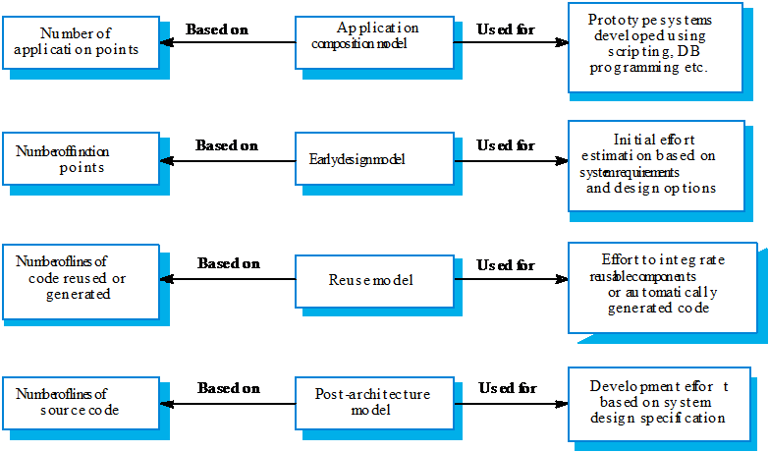
Use of COCOMO 2 models

Slide 52
Application composition model
Supports prototyping projects and projects where there is extensive reuse.
Based on standard estimates of developer productivity in application (object) points/month.
Takes CASE tool use into account.
Formula is
PM = ( NAP × (1 - %reuse/100 ) ) / PROD
PM is the effort in person-months, NAP is the number of application points and PROD is the productivity.

Slide 53
Object point productivity
DeveloperÕs experience and capability
ICASE maturity and capability
PROD (NOP/month)
Very low
Low Low | Nominal Nominal | High High | Very high Very high
7 | 13 | 25 | 50
Very low
4

Slide 54
Early design model
Estimates can be made after the requirements have been agreed.
Based on a standard formula for algorithmic models
PM = A × Size^{B} × M where
M = PERS × RCPX × RUSE × PDIF × PREX × FCIL ×
SCED;
A = 2.94 in initial calibration, Size in KLOC, B varies from 1.1 to 1.24 depending on novelty of the project, development flexibility, risk management approaches and the process maturity.

Slide 55
Multipliers
Multipliers reflect the capability of the developers, the non-functional requirements, the familiarity with the development platform, etc.
RCPX - product reliability and complexity;
RUSE - the reuse required;
PDIF - platform difficulty;
PREX - personnel experience;
PERS - personnel capability;
SCED - required schedule;
FCIL - the team support facilities.

Slide 56
The reuse model
Takes into account black-box code that is reused without change and code that has to be adapted to integrate it with new code.
There are two versions:
Black-box reuse where code is not modified. An effort estimate (PM) is computed.
White-box reuse where code is modified. A size estimate equivalent to the number of lines of new source code is computed. This then adjusts the size estimate for new code.

Slide 57
Reuse model estimates 1
For generated code:
PM = (ASLOC * AT/100)/ATPROD
ASLOC is the number of lines of generated code
AT is the percentage of code automatically generated.
ATPROD is the productivity of engineers in integrating this code.

Slide 58
Reuse model estimates 2
When code has to be understood and integrated:
ESLOC = ASLOC * (1-AT/100) * AAM.
ASLOC and AT as before.
AAM is the adaptation adjustment multiplier computed from the costs of changing the reused code, the costs of understanding how to integrate the code and the costs of reuse decision making.

Slide 59
Post-architecture level
Uses the same formula as the early design model but with 17 rather than 7 associated multipliers.
The code size is estimated as:
Number of lines of new code to be developed;
Estimate of equivalent number of lines of new code computed using the reuse model;
An estimate of the number of lines of code that have to be modified according to requirements changes.

Slide 60


Slide 61

On large projects, hundreds of small tasks must occur to accomplish a larger goal
Project manager's objectives
•
•
Define all project tasks
Build an activity network that depicts their interdependencies
Identify the tasks that are critical within the activity network
Build a timeline depicting the planned and actual progress of each task
Track task progress to ensure that delay is recognized "one day at a time
"
To do this, the schedule should allow progress to be monitored and the project to be controlled
–
–
–
–
–
–
4

Slide 62
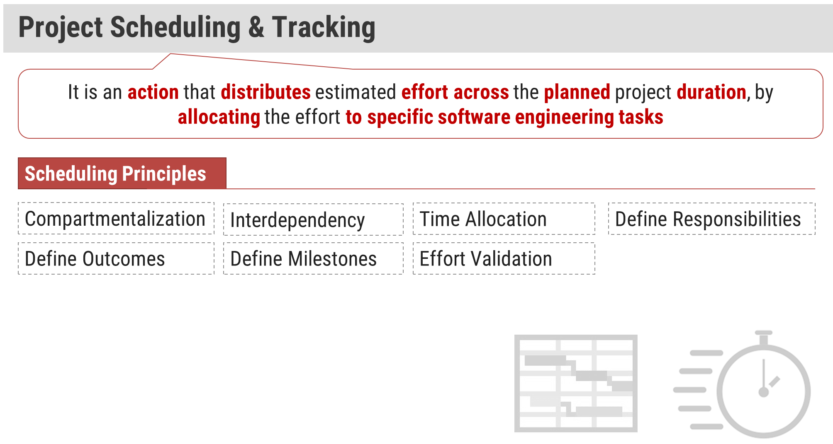

Slide 63

Compartmentalization
•
– The project must be compartmentalized into a number of manageable activities, actions, and tasks; both the product and
the process are decomposed
Interdependency
•
– The interdependency of each compartmentalized activity, action, or task must be determined
–
Some tasks must occur in sequence while others can occur in
parallel
– Some actions or activities cannot commence until the work product produced by another is available
•
Time allocation
– Each task to be scheduled must be allocated some number of work units
–
In addition, each task must be assigned a start date and a
completion date that are a function of the interdependencies Start and stop dates are also established based on whether work
–
will be conducted on a full-time or part-time basis
(More on next slide)
6

Slide 64

Effort validation
•
–
–
Every project has a defined number of people on the team
As time allocation occurs, the project manager must ensure that
no more than the allocated number of people have been
scheduled at any given time
•
Defined responsibilities
– Every task that is scheduled should be assigned to a specific team member
•
Defined outcomes
Every task that is scheduled should have a defined outcome for
software projects such as a work product or part of a work product
Work products are often combined in deliverables
•
Defined milestones
– Every task or group of tasks should be associated with a project
–
milestone
A milestone is accomplished when one or more work products
has been reviewed for quality and has been approved
7

Slide 65


Slide 66

A task set is the work breakdown structure for the project
•
•
No single task set is appropriate for all projects and process models
It varies depending on the project type and the degree of rigor (based on influential factors) with which the team plans to work
The task set should provide enough discipline to achieve high software quality
But it must not burden the project team with unnecessary work
•
9

Slide 67

Size of the project Number of potential users Application longevity Stability of requirements
Ease of customer/developer communication Maturity of applicable technology Performance constraints
•
•
•
•
•
•
•
•
•
•
Embedded and non-embedded characteristics Project staff
Reengineering factors
11

Slide 68

Also called an activity network
It is a graphic representation of the task flow for a project
•
•
•
It depicts task length, sequence, concurrency, and dependency
Points out inter-task dependencies to help the manager ensure continuous progress toward project completion
The critical path
•
•
–
–
A single path leading from start to finish in a task network
It contains the sequence of tasks that must be completed on schedule if the project as a whole is to be completed on schedule
It also determines the minimum duration of the project
–
12

Slide 69

Task F
2
Task G
3
Task H 5
Task B 3
Task N 2
Task A 3
Task C
7
Task E
8
Task I 4
Task J 5
Task M 0
Task D 5
Task K
3
Task L 10
Where is the critical path and what tasks are on it?
13

Slide 70

Task F
2
Task G
3
Task H 5
Task B 3
Task N 2
Task A 3
Task C 7
Task E
8
Task I 4
Task J 5
Task M 0
Task D 5
Task K 3
Task L 10
Critical path: A-B-C-E-K-L-M-N
14

Slide 71


Slide 72


Also called a Gantt chart;
All project tasks are listed in the far left column
•
•
•
The next few columns may list the following for each task: projected start date, projected stop date, projected duration, actual start date, actual stop date, actual duration, task inter-
dependencies (i.e., predecessors)
To the far right are columns representing dates on a calendar
•
•
The length of a horizontal bar on the calendar indicates the
duration of the task
•
When multiple bars occur at the same time interval on the
calendar, this implies task concurrency
•
A diamond in the calendar area of a specific task indicates that
the task is a milestone; a milestone has a time duration of zero
Jan Feb Mar Apr May Jun Jul Aug Sep Oct
Task # | Task Name | Duration | Start | Finish | Pred.
1 | Task A | 2 months | 1/1 | 2/28 | None
2 | Milestone N | 0 | 3/1 | 3/1 | 1
16

Slide 73
SOLUTION
Timeline chart:
4/1 4/8 4/15
4/22 4/29 5/6 5/13 5/20 5/27 6/3
Task # | Task Name | Duration | Start | Finish | Pred.
A | Establish increments | 3 | 4/1 | 4/3 | None
B | Analyze Inc One | 3 | 4/4 | 4/6 | A
C | Design Inc One | 8 | 4/7 | 4/14 | B
D | Code Inc One | 7 | 4/15 | 4/21 | C
E | Test Inc One | 10 | 4/22 | 5/1 | D
F | Install Inc One | 5 | 5/2 | 5/6 | E
G | Analyze Inc Two | 7 | 4/7 | 4/13 | A, B
H | Design Inc Two | 5 | 4/14 | 4/18 | G
I | Code Inc Two | 4 | 4/19 | 4/22 | H
J | Test Inc Two | 6 | 5/2 | 5/7 | E, I
K | Install Inc Two | 2 | 5/8 | 5/9 | J
L | Close out project | 2 | 5/10 | 5/11 | F, K
Task network and the critical path:
A-B-C-D-E-J-K-L
B. Analyze Inc One
3
C. Design Inc One
8
D. Code Inc One
7
E. Test Inc One
10
F. Install Inc One
5
A. Establish Increments
3
L. Close out Project
2
G. Analyze Inc Two
7
H. Design Inc Two
5
I. Code Inc Two
4
J. Test Inc Two
6
K. Install Inc Two
2
17

Slide 74

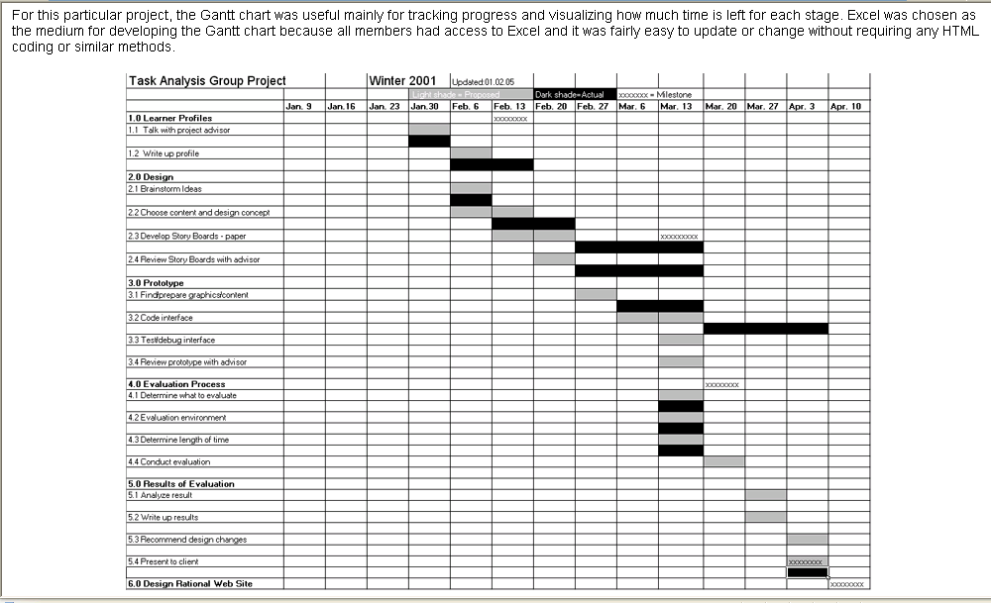
1

Slide 75

Qualitative approaches
•
– Conduct periodic project status meetings in which each team member reports progress and problems
–
Evaluate the results of all reviews conducted throughout the
software engineering process
–
Determine whether formal project milestones (i.e., diamonds)
have been accomplished by the scheduled date
–
Compare actual start date to planned start date for each
project task listed in the timeline chart
–
Meet informally with the software engineering team to obtain
their subjective assessment of progress to date and problems
on the horizon
Quantitative approach
•
– Use earned value analysis to assess progress quantitatively
19

Slide 76
Schedule Tracking Tools
Microsoft Project :
Helps project managers in
Developing the project plan
Assigning the resource to the tasks
Tracking the progress
Managing the budgets
Analysis of Workload
Daily Activity Report Tool (DART)

Slide 77
THANK YOU

